Slide 1

Evaluation of Models – Overview of Models Run
Thirty-six model runs on three separate datasets
Eight classification models and four regression models
Pre-selected Gradient Boosted Classifier based on the model high Accuracy, Precision, Recall, and F1 Score

Slide 2
Validating the Accuracy Score – Gradient Boosted Classification
k-Fold Cross-Validation is a resampling procedure used to evaluate machine learning models on a limited data sample.
We run a 10-fold cross-validation on the entire dataset to estimate the skill of a machine learning model on unseen data.
We observed that the accuracy scores were high and reasonably consistent from fold to fold
We further noted a high mean accuracy score with a low standard deviation
We concluded that the model accuracy score number was reliable

Slide 3
Checking for Overfitting – Gradient Boosted Classifier
We run a on the 10 folds cross validation complete dataset, the test dataset, and the training datasets.
Further we compared the cross-validation results to ensure their consistency thus that the model was not overfitting
We concluded based on the differences between 10-fold CV mean scores and related standard deviations that the likelihood that model was overfitting was low.

Slide 4
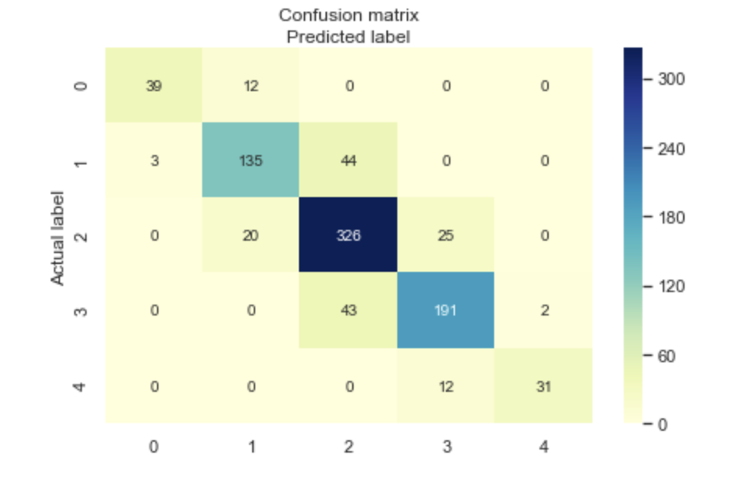
Checking for Accuracy Paradox – Gradient Boosted Classifier
The accuracy paradox is the paradoxical finding that accuracy is not a good metric for predictive models when classifying in predictive analytics.
We checked for the accuracy paradox by running a confusion matrix and a Sklearn classification report. A confusion matrix is a summary of prediction results on a classification problem.
We concluded that our Gradient Boosted Classifier was not victim of an Accuracy Paradox based on the high recall, high precision and high F1 score values shown in classification report, as well as the low number of false positive and false negative shown in the confusion matrix

Slide 5
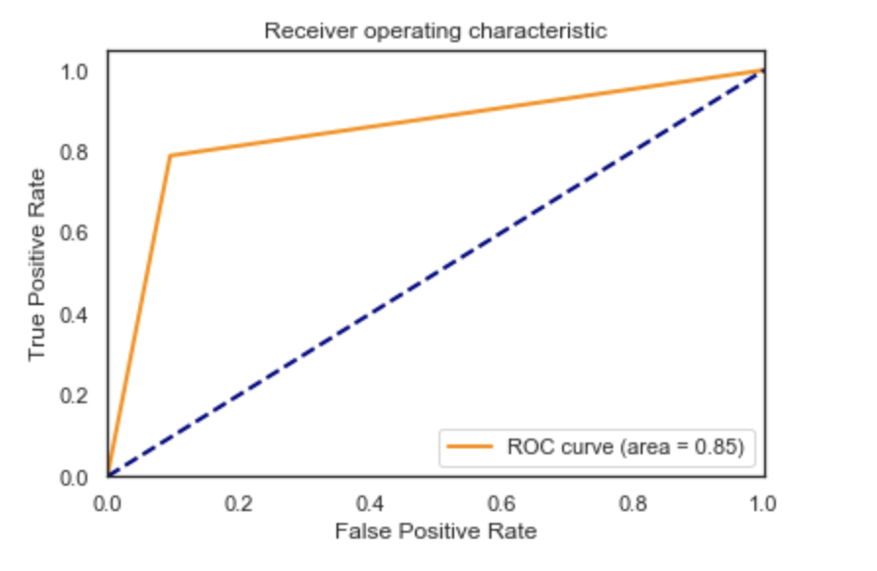
Checking for Classification Ability – Gradient Boosted Classifier
ROC is a probability curve and AUC represents degree or measure of separability. It tells how much model is capable of distinguishing between classes. Higher the AUC, better the model is.
We concluded that our model has a reasonably good classification ability based on the value probability of correct classification of 85% shown in the ROC AUC plot

